Slide 1

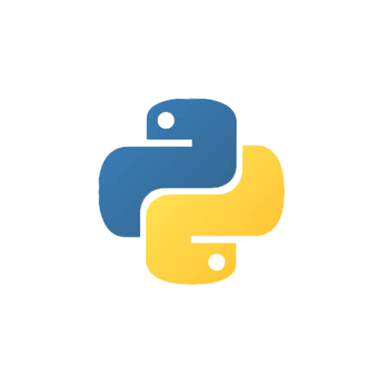
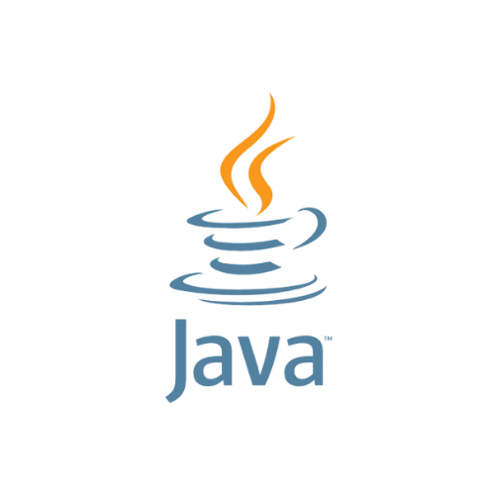
Difference Between Python and Java
Characteristics, Use cases & Advantages

Slide 2
Overview
Python and Java are two of the most popular programming languages.
They are widely used in software development, data science, web development, and enterprise solutions.

Slide 3
Key Characteristics of Python
High-level, interpreted language.
Emphasis on code readability with a simple syntax.
Dynamically typed, with strong support for scripting and automation.
Extensive standard library and large community support.

Slide 4
Key Characteristics of Java
Object-oriented, class-based language.
Statically typed, with strong emphasis on portability (Write Once, Run Anywhere).
Compiled into bytecode, which runs on the Java Virtual Machine (JVM).
Rich set of libraries and frameworks for enterprise solutions.

Slide 5
Python vs. Java: Syntax
• Python's syntax is concise and easier for beginners.
• Java's syntax is more verbose but offers explicit type declarations.
• Example Code Snippets: 'Hello, World!' in Python and Java.

Slide 6
Common Use Cases for Python
• Data Science and Machine Learning (e.g., Pandas, TensorFlow).
• Web Development (e.g., Django, Flask).
• Automation and Scripting (e.g., DevOps, task automation).
• Rapid prototyping and startups.

Slide 7
Common Use Cases for Java
Enterprise-level applications (e.g., banking, retail).
Android app development.
Large-scale systems and back-end servers (e.g., Spring, Hibernate).
Embedded systems and IoT devices.

Slide 8
Python vs. Java: Performance
• Java is generally faster due to compiled nature and JVM optimizations.
• Python may be slower but excels in development speed and ease of use.
• Situational performance: Java for high-performance applications, Python for rapid development.

Slide 9
Ecosystem and Community Support
• Python's vibrant community with extensive libraries for data science, AI, and web development.
• Java’s robust ecosystem with mature frameworks for enterprise applications.
• Comparison of package managers (pip vs. Maven/Gradle).

Slide 10
Ease of Learning and Adoption
Python is often recommended for beginners due to its simplicity and readability.
Java has a steeper learning curve but offers a deep understanding of object-oriented programming.
Suitability for different types of learners and project requirements.

Slide 11
Advantages of Using Python
Rapid development and prototyping.
Large selection of libraries for specialized tasks.
Cross-platform compatibility.
Easy integration with other technologies.

Slide 12
Advantages of Using Java
• Platform independence (JVM).
• Strong performance and scalability.
• Robust security features.
• Extensive use in enterprise and Android development.

Slide 13
Python or Java: Which to Choose?
• Consider project requirements, team expertise, and long-term goals.
• Python for rapid development, prototyping, and data science.
• Java for large-scale, high-performance, and enterprise applications.

Slide 14
References and Additional Resources
• Official Python documentation: https://docs.python.org/3/
• Official Java documentation: https://docs.oracle.com/en/java/

